Slide 1
Post Conference Presentation
Tariro Mukute

Slide 2
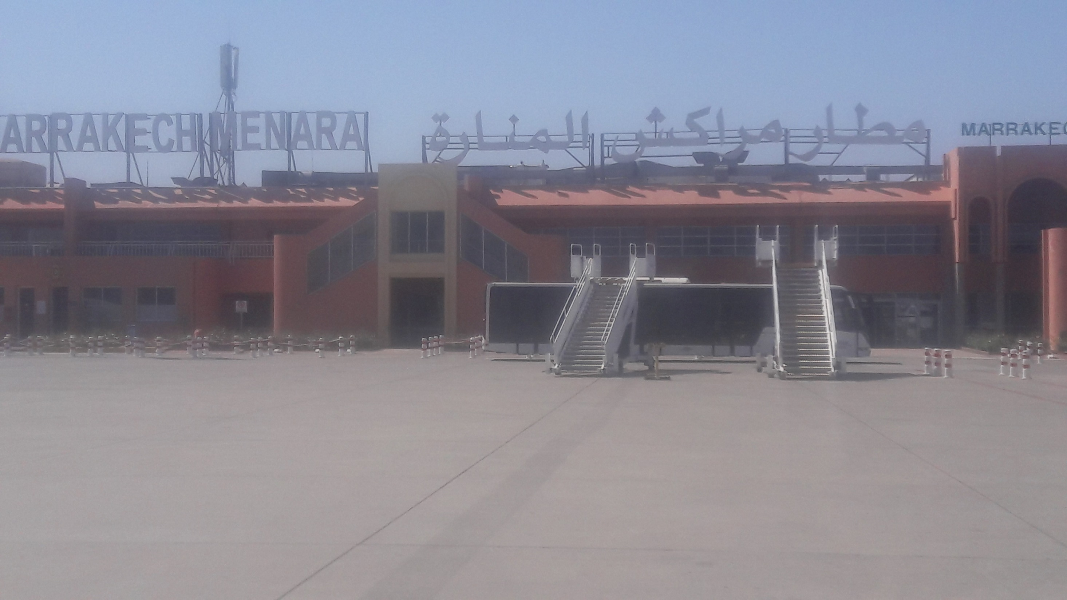

Slide 3
Introduction
2019
City: Marrakech

Slide 4
Introduction

Slide 5
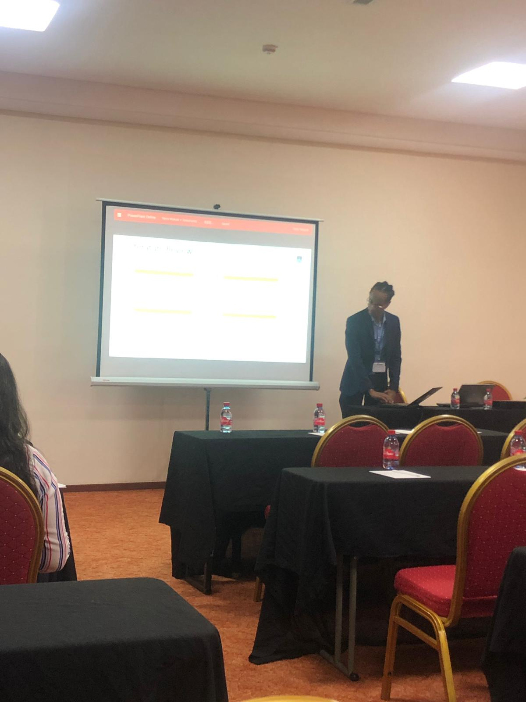
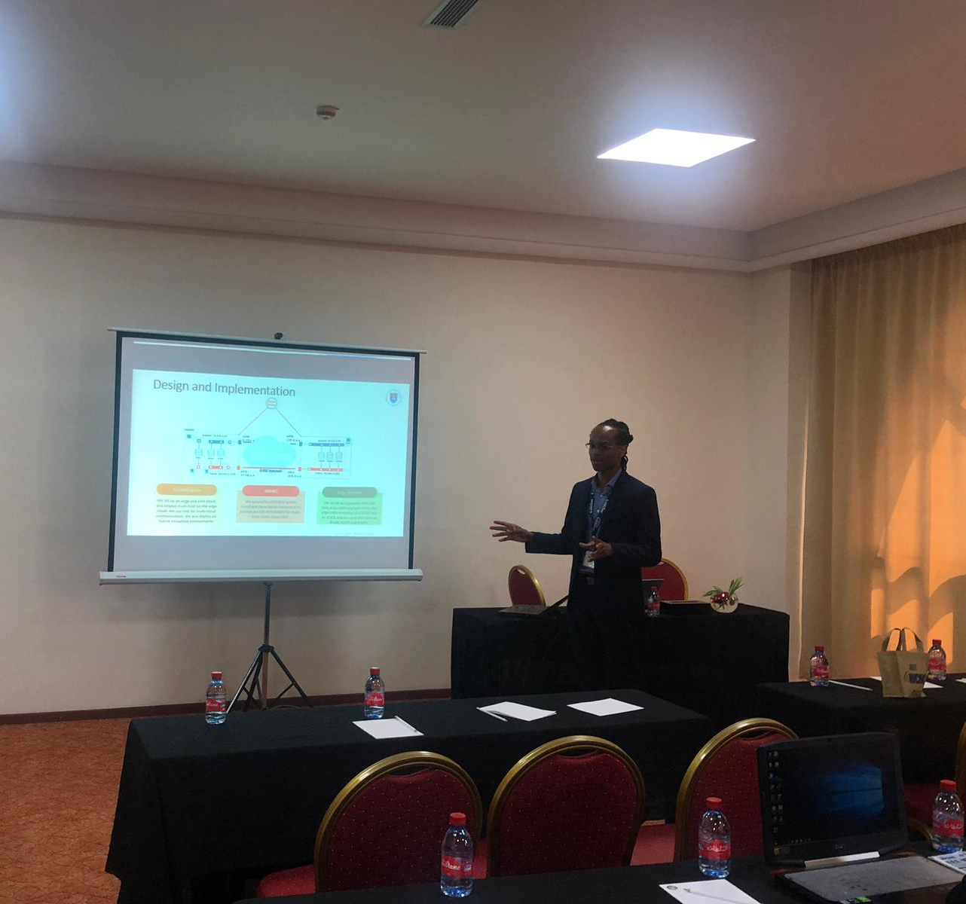

Slide 6
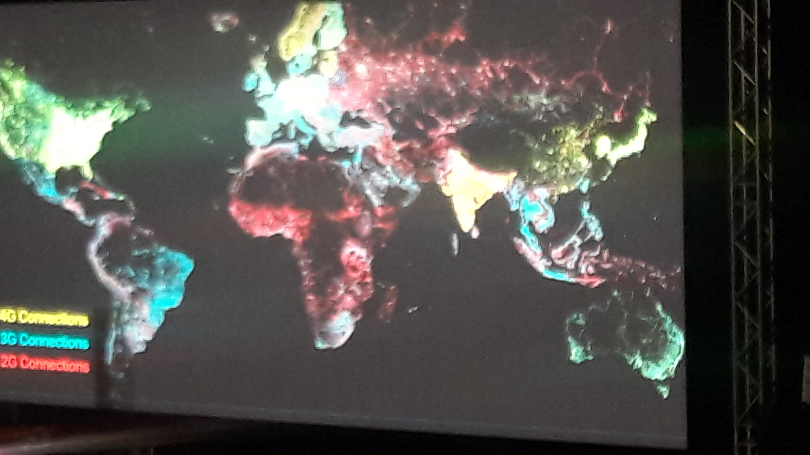

Slide 9
Research Areas
Machine Learning in Access Networks
Test beds
Rural Digitalization

Slide 10
THANK YOU

